Slide 1
Cloud Security
Florent Dondjeu Tschoufack

Slide 2
Cloud Computing
A delivery of on-demand computing services over the internet that can be rapidly provisioned and released with minimal service provider interaction.
In simpler terms, its big warehouse with many servers that are accessible to many.
Such model is composed of:
5 essential characteristics
3 service models
4 deployment methods

Slide 3
Characteristics
Broad network access
available over the network and accessible through standard mechanism
Rapid elasticity
ability to expand or reduce resources according to individual’s needs
Measured service
resources controlled and optimized by cloud system
On demand self service
consumer can observe computing capabilities
Resource pooling
Cloud service provider (CSP) can serve multiple consumers

Slide 4
Service Models
Software as a service (SaaS)
CSP’s application accessible through various client device e.g Web browser
Removes the need of software install, maintenance, upgrades and patches.
Platform as a service (PaaS)
Operating system on the cloud
Consumer being able to use programming languages, databases etc.. supported by provider
Infrastructure as a service (Iaas)
Allow consumer to view processing, network, and other fundamentals resources enabling them to build highly adaptable computer systems

Slide 5
Deployment Methods
Public cloud
Cloud infrastructure is available to thee general public
CSP is responsible for the control of data and operations within the cloud
Private cloud
Cloud infrastructure is operated only for an organization
CSP manages infrastructure but not control
Hybrid cloud
Composition of two or more clouds that are unique but only bounded by standardized technology
Community cloud*

Slide 6
Current CSPs
Major CSP
AWS, Microsoft Azure, Google Cloud Platform, Alibaba, IBM
Fun fact: Netflix uses AWS for all its computer and storage needs instead of making its own data center.
Security control on the cloud is very similar to any IT environment but due to its operational models cloud computing have risks specific to a cloud environment.

Slide 7
Cloud Security Risk
Security as a service (SecaaS) can be looked at as a package of security services offered by a service provider.
Top cloud security threats:
Abuse and nefarious use of cloud computing
Insecure interfaces and APIs
Malicious insiders
Data loss
Shared technology issues
Account or service hijacking
Unknown risk profile

Slide 8
Concern
Now that all of the consumer’s data is on the cloud, how can they be certain of the data integrity given a scenario where CSP may choose to hide data errors or use for malicious intentions.
We need a method for the client to find an efficient way to periodically check the integrity without the local copy of data files.
Clients themselves are unreliable which introduces the need for a third party auditor (TPA).

Slide 9
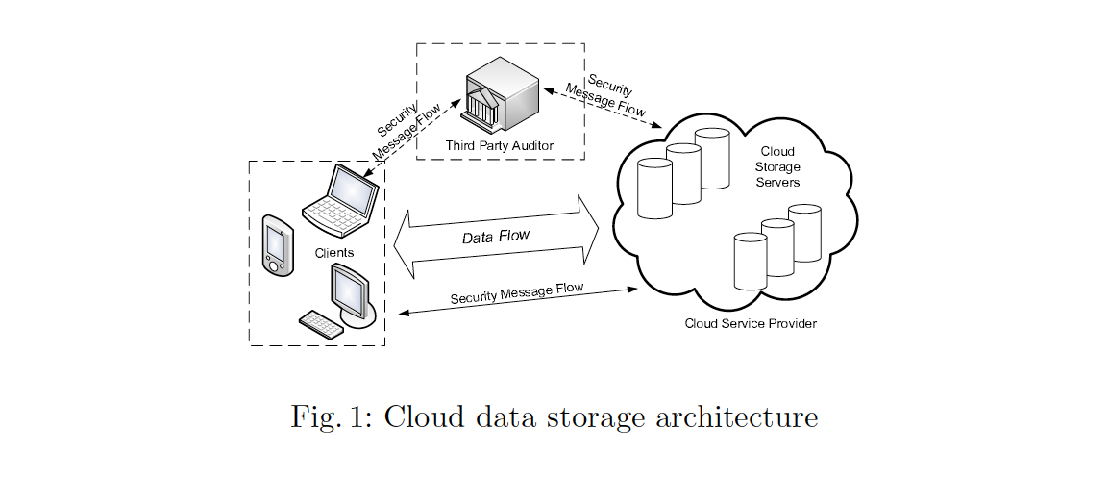
Proposal
Wang, Qian et al. “Enabling Public Verifiability and Data Dynamics for Storage Security in Cloud Computing.” ESORICS(2009).
Proposed a protocol for public (anyone) verification with use of Bilinear Map and Merkle Hash Tree

Slide 10
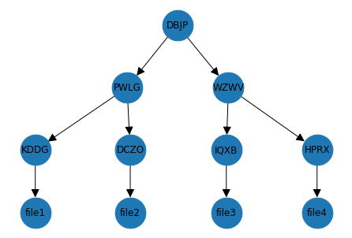
Merkle Hash Tree

Slide 11
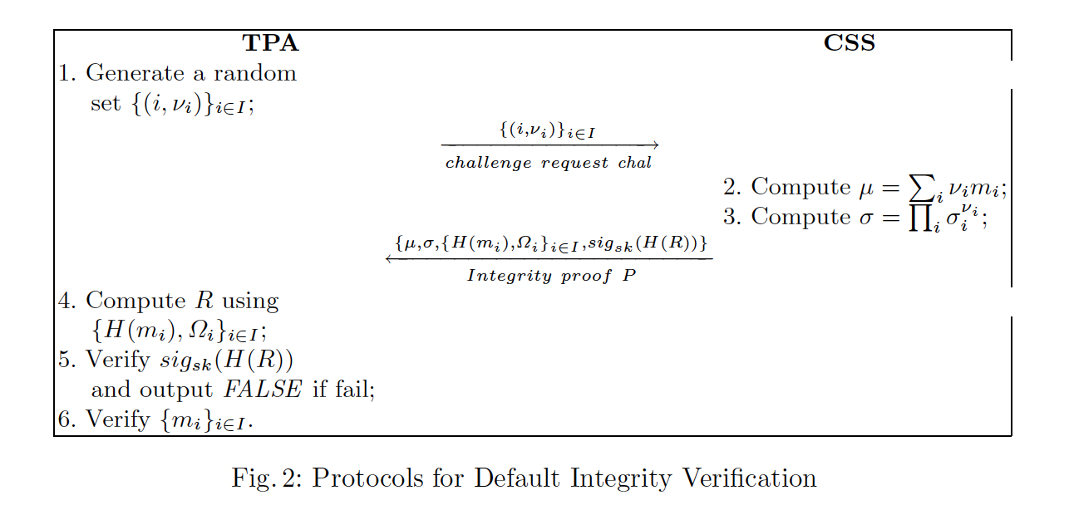

Slide 12
Implementation

Slide 13
References
“Cloud Computing Explained.” Youtube, PowerCert Animated Videos, Nov 2021. https://youtu.be/_a6us8kaq0g.
“Data corruption and Merkle trees.” Youtube, Tech Dummies Narendra L, Apr 2020. https://youtu.be/rsx1nt2bxf8.
Stallings, William. Network Security Essentials: Application and Standards. Pearson, 2017.

